Slide 1
Your first games
Created by Jayson McCune

Slide 2
objectives
Basic Number Guessing Game
Making Nice Buttons
Seeing the Game
Alien Attack

Slide 3
Basic number guessing game
Going to ask the player to guess a random number between 0 and 99
Allow the player to enter a guess in a text field by clicking on a button
Use an if statement to figure out if the number is greater, less than or the same as the random number
Display a message that tells the player if they guessed too low, too high, or are correct

Slide 4




Guess the Number Screenshots

Slide 5

Guess the Number Html

Slide 6
Guess the number javascript
Variables for each button, text field and paragraph tag
Event listener for the button
Functions to separate out the code into discrete steps to solve each problem

Slide 7
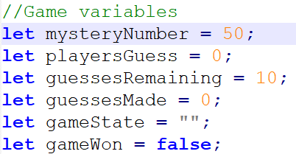
Javascript variables
We start with the mystery number that the player has to guess
Next we have the variable to store the player’s guess
Then the variable to keep track of how many guesses remain
We then have a variable to keep track of the number of guesses
We have a variable for game state
The last variable is a Boolean to keep track of the win condition

Slide 8
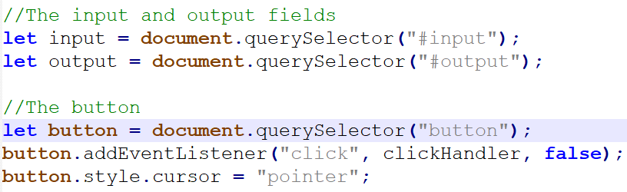
Javascript query
The variables to connect to the input and output HTML tags
Variable to connect to the HTML button
Change the cursor to a hand pointer
Add the event listener to the button

Slide 9
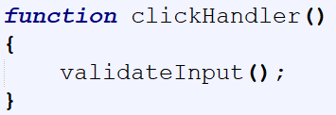
clickhandler function
Clickhandler function calls another helper function named validateInput

Slide 10
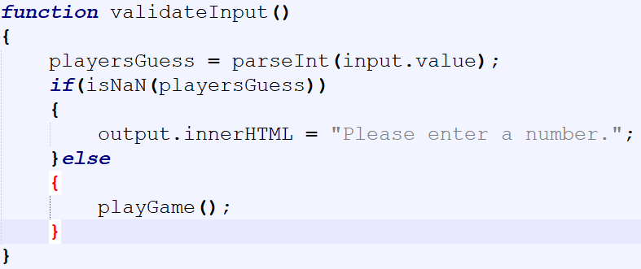
Validate input function
We pull the input text field value in and convert it to an integer with parseInt
Use the if statement to check to see if the player entered anything
If the input text field is empty output an error message
Otherwise call the playGame helper function

Slide 11
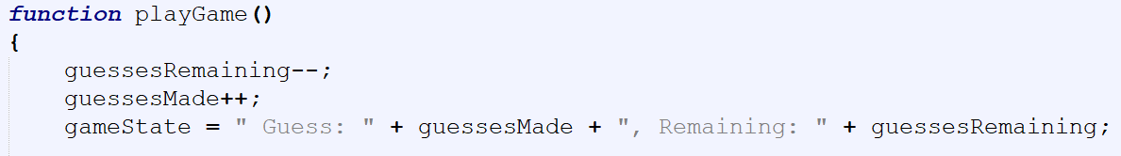
Play game function
Start by decrementing the guessesRemaining variable
Then increment the guessesMade variable
Lastly set the gameState variable to the message that will be displayed

Slide 12
Play game function cont’d
Series of if/else statements to play the game
First if checks to see if the player’s guess is higher than the mystery number
If it is then output the correct message
If the guesses remaining is less than 1 then the user has run out of guesses and the game is over
Second if checks to see if the player’s guess is lower than the mystery number
If it is then output the correct message
If the guesses remaining is less than 1 then the user has run out of guesses and the game is over
Lastly check if the player’s guess is correct
If it is then output the correct message
Set the gameWon variable to true

Slide 13
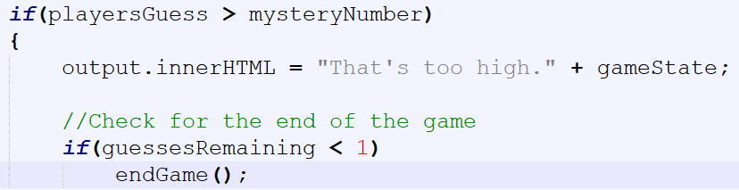
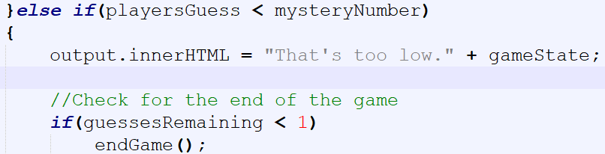
screenshots

Slide 14
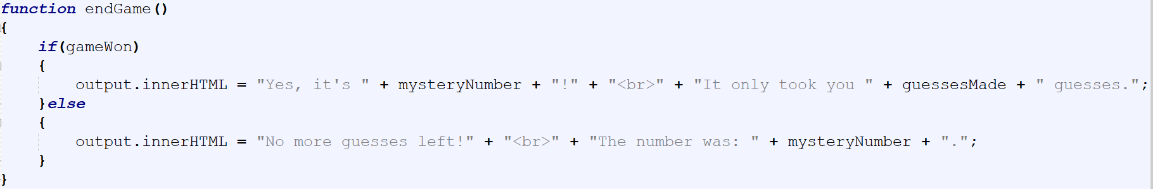
End game function
Check to see if the gameWon variable is true or false
If it is true then the player guessed the number
Output the correct message
Otherwise the player lost
Output the correct message

Slide 15
Polishing up
Using the Enter key
Improving the User Interface(UI)
Creating random numbers
Finishing the game

Slide 16
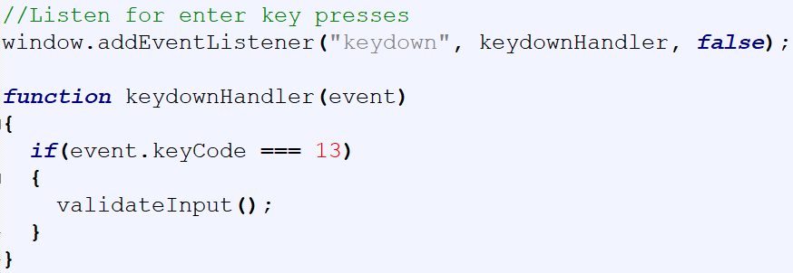
Using Enter key
Add an event listener for key down to the window
Check to see if it is the enter key (13)
All keys when pressed give a number for what key is pressed

Slide 17
Improve the user interface(ui)
Add focus for the text field
Cursor will start in the input text field
Add autofocus to the input tag in the HTML file

Slide 18
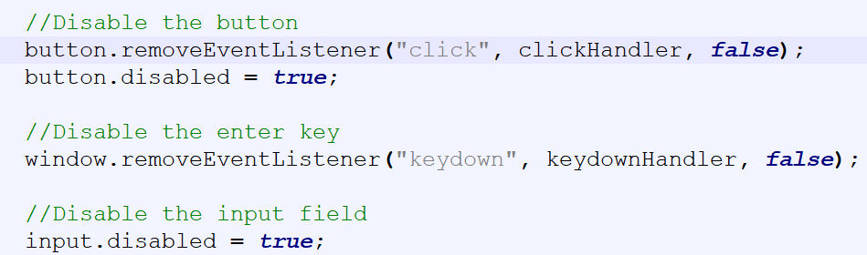
Improve the Ui cont’d
Disable the input field button and enter key after the game is over
Add this to the end of the endGame function
Remove the event listeners for the window and button

Slide 19
Creating random numbers
Use Math.random() in place of the numerical literal for the mystery number variable
Use Math.floor() to make the random number a whole number
Multiply the Math.random by 100 to get a number between 0 and 99

Slide 20
Finishing the game
Look for the complete code in Module Resources in this week’s module on Canvas

Slide 21
Making really nice buttons
Do these with CSS
Adding a hover effect
Adding a click effect
Adding an up effect

Slide 22
Experimental styles
New experimental CSS styles
Border-radius
Linear-gradient
Box-shadow
Need to add lines to make these styles work in different browsers
-webkit will work on Safari and Chrome
-moz will work on Firefox

Slide 23
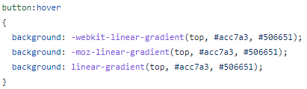
Adding a Hover effect
When your mouse moves over it, there’s a highlighting effect
This is determined by the :hover state

Slide 24
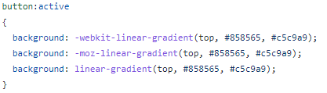
Adding a click effect
When you click or hold the mouse button down, the button often changes color. Sometimes it will change position slightly to appear as though it’s being pressed down.
This is determined by the :active state

Slide 25
Adding an up effect
The button returns to normal when the mouse leaves it

Slide 26
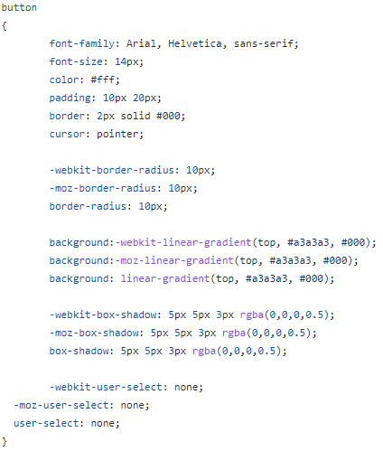
Adding an up effect Cont’d

Slide 27
Button styles
Border-radius determines how rounded the corners of the button will be
Linear-gradient creates a gradual change in the buttons color from light to dark
Box-shadow creates a drop shadow effect on the button
User-select determines whether or not the user can select the text in the button

Slide 28
Seeing the game
We are going to add a sliding bar image to the number guessing game that will move with the user’s guess
Will need the two images in a folder to add them to the html page
Add the images using CSS
Use JavaScript to move the arrow down the sliding scale when a user enters a guess

Slide 29
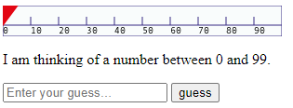
Seeing the game cont’d

Slide 30
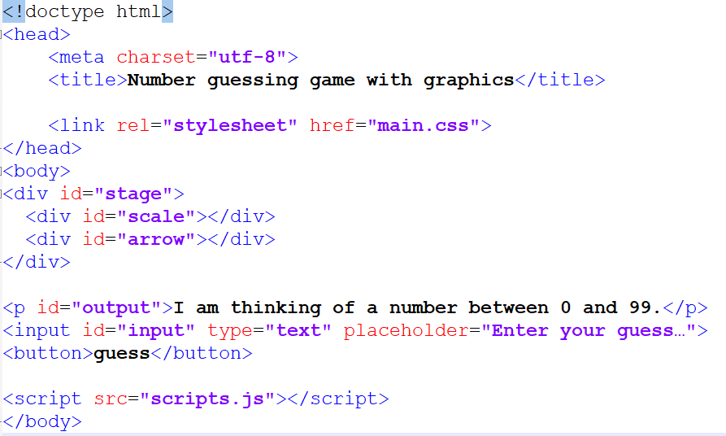
Html for seeing the game

Slide 31
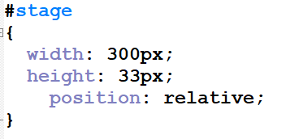
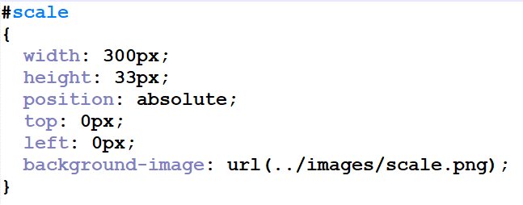
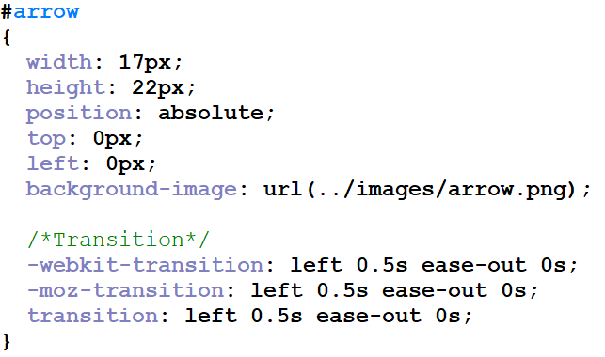
Css for seeing the game

Slide 32
Css for seeing the game cont’d
The three different transitions are for the different browsers
Webkit is for Chrome and Safari
Moz is for Firefox
These allow the different browsers to display the elements the same

Slide 33
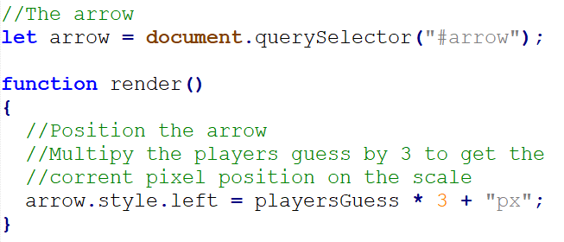
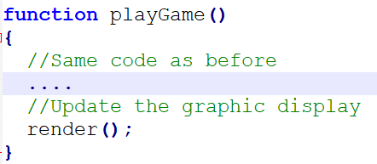
javascript for seeing the game
Additions to the number guessing game JavaScript
The scale image is 300 pixels wide
The arrow is moved by the player’s guess times 3, pixels

Slide 34
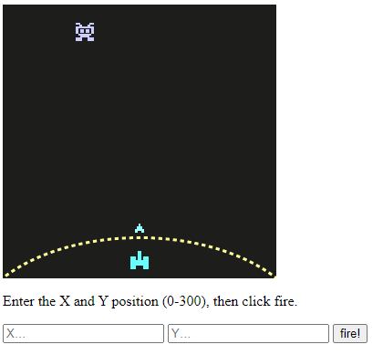
Alien Attack
Guess the X and Y location of where an alien invasion ship is going to be
Game will have four images that are used and the rest will be done with html, css, and javascript

Slide 35
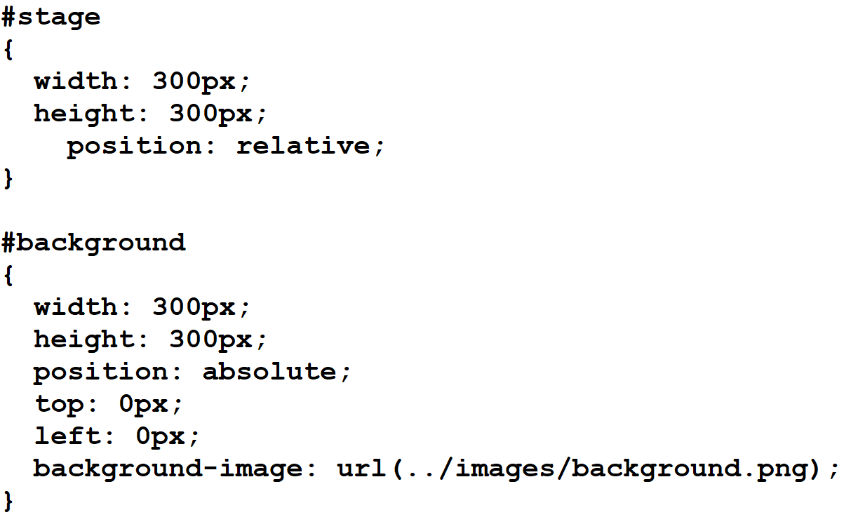
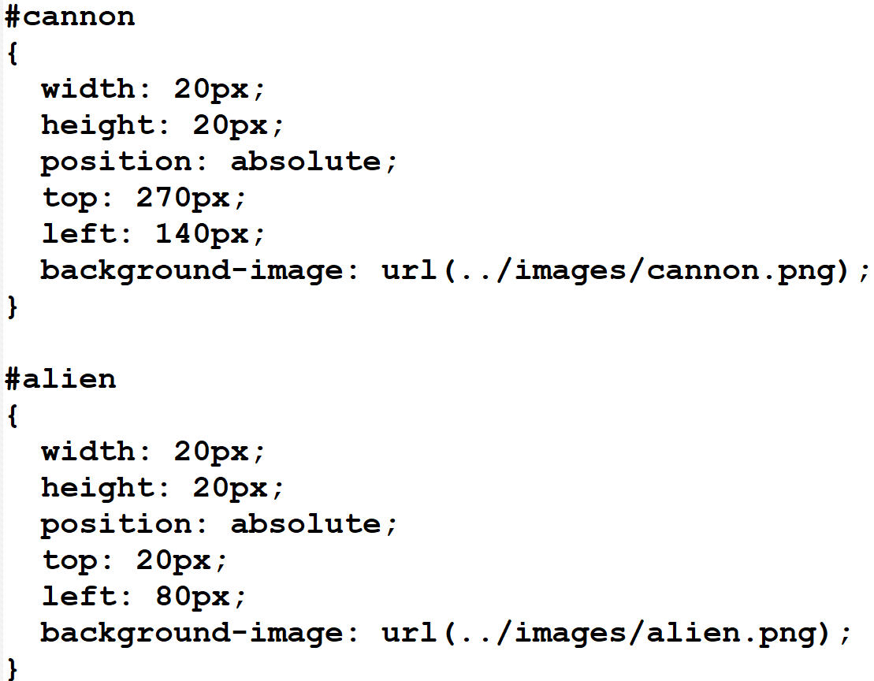
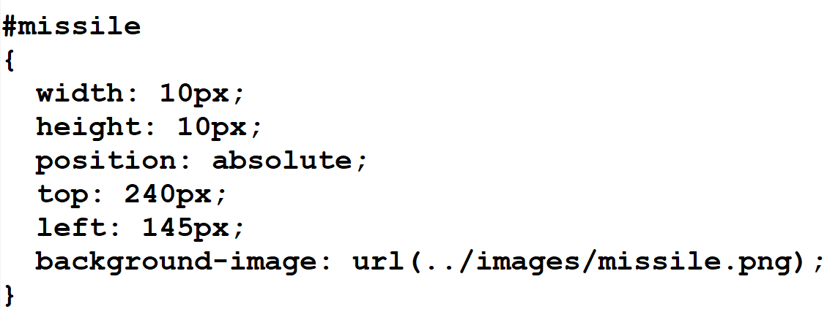
Alien attack css

Slide 36
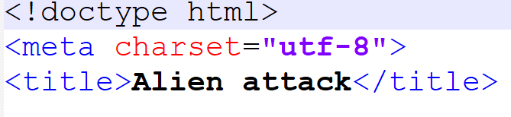
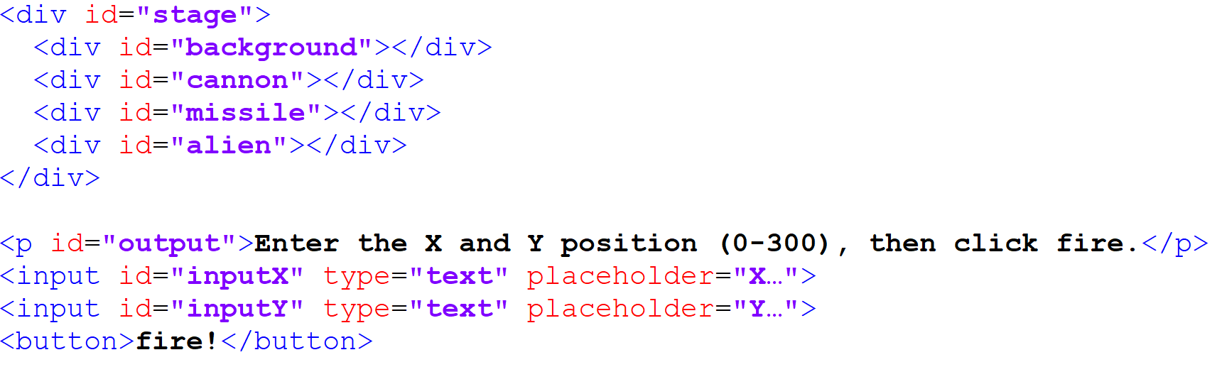
Alien attack html

Slide 37
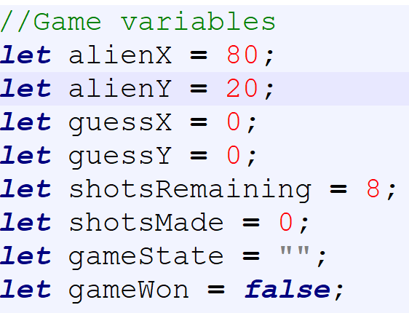
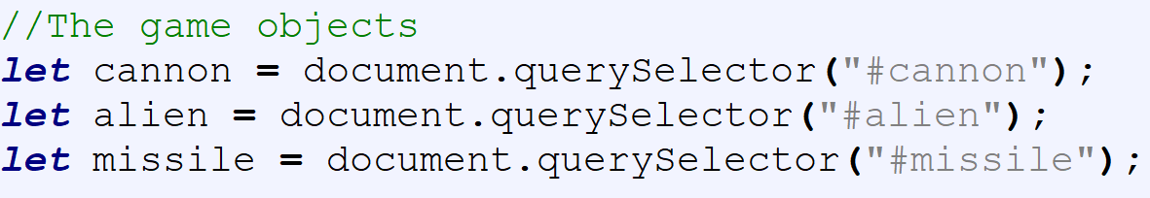
Alien attack javascript

Slide 38
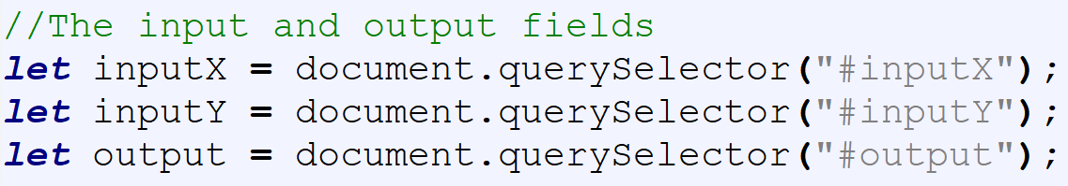
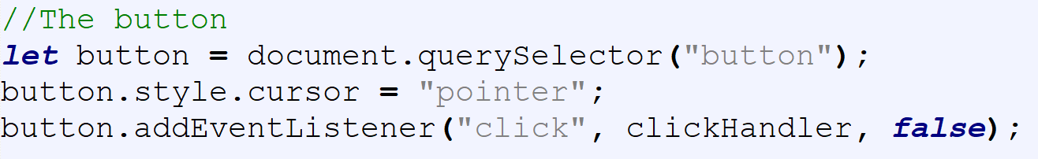
Alien attack javascript cont’d

Slide 39
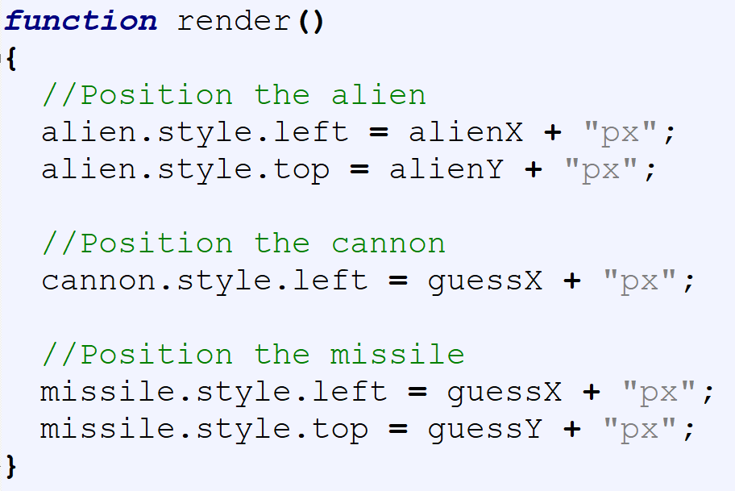
Alien attack javascript cont’d

Slide 40
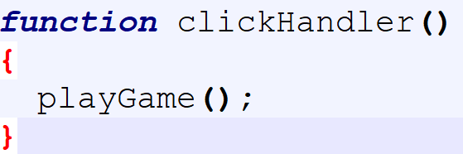
Alien attack javascript cont’d

Slide 41
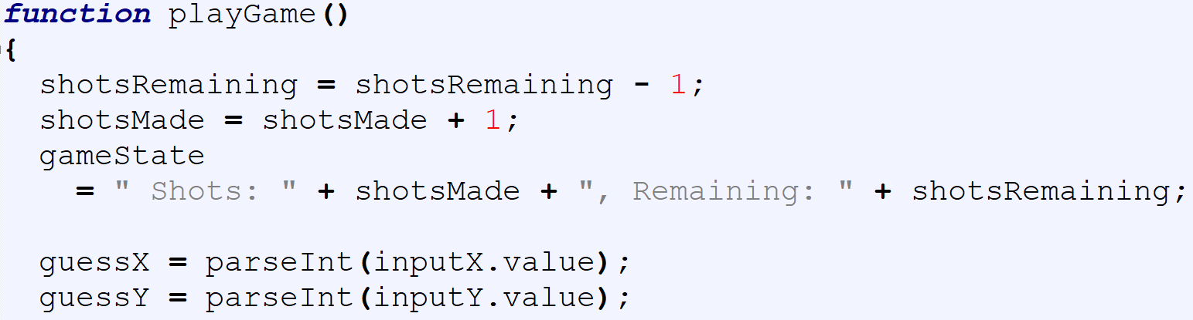
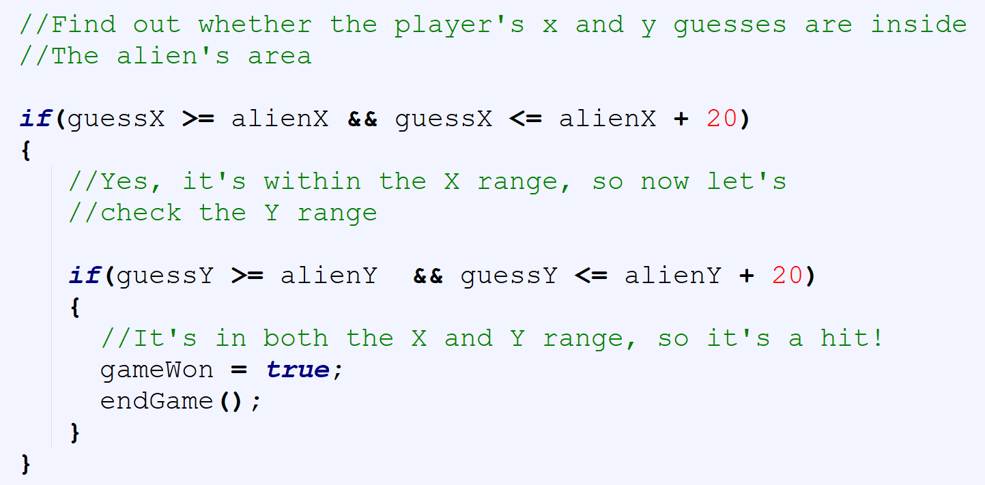
Alien attack javascript cont’d

Slide 42
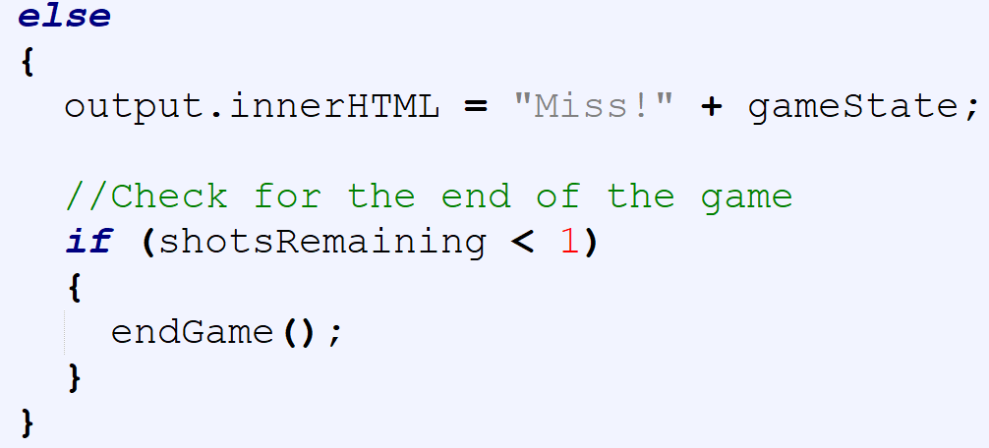
Alien attack javascript cont’d

Slide 43
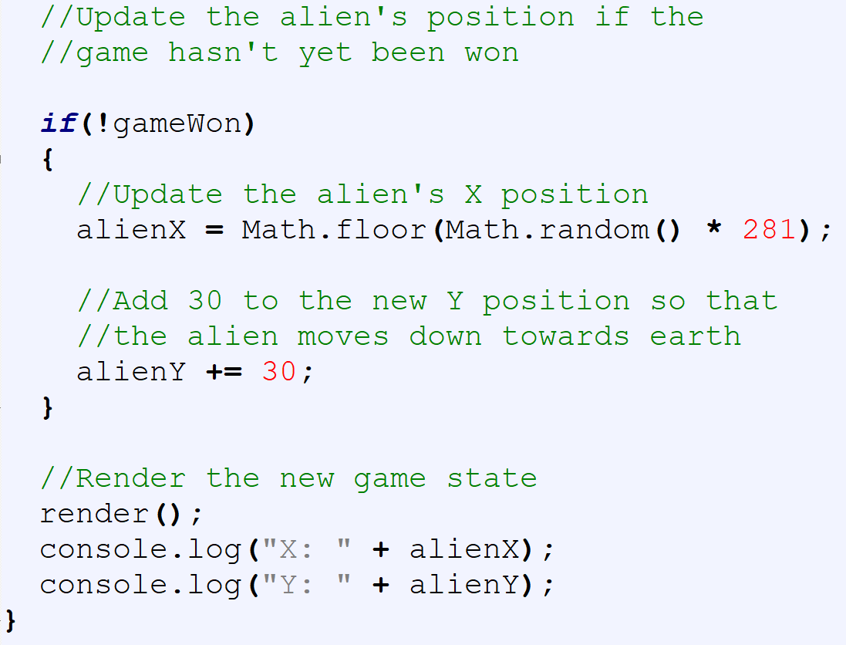
Alien attack javascript cont’d

Slide 44
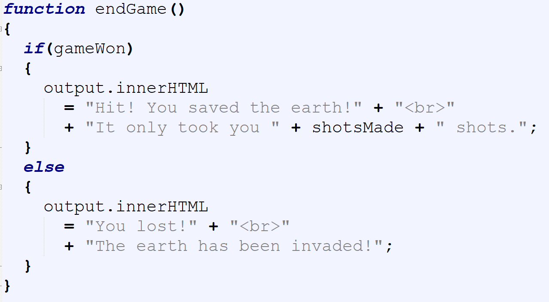
Alien attack javascript cont’d

